Slide 1
TASK -4
SUMMARY- ONLINE SALES DATA

Slide 2
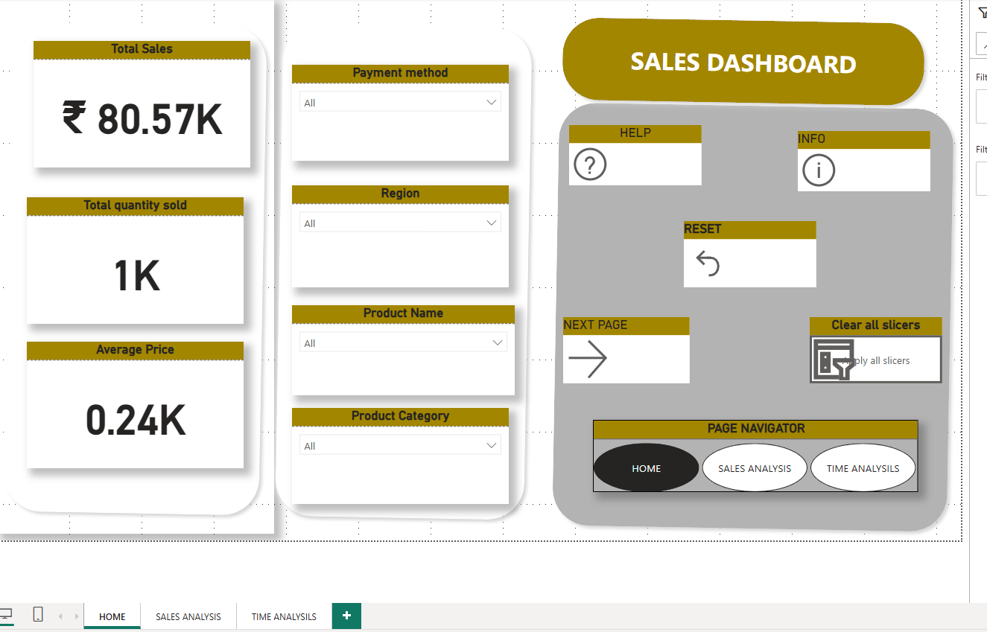

Slide 3
Slide 1: Sales Dashboard - Key Metrics & Filters
This slide represents the main Sales Dashboard, providing an at-a-glance view of key sales figures and interactive filters.
Key Sales Metrics (KPIs):
Total Sales: ₹ 80.57K
Total Quantity Sold: 1K units
Average Price: 0.24K (₹240)
Interactive Filters/Slicers:
Payment method
Region
Product Name
Product Category
Navigation & Controls:
HELP & INFO buttons
RESET function
NEXT PAGE button (likely leading to Sales Analysis)
"Clear all slicers" option
Page Navigator:
HOME (Current Page)
SALES ANALYSIS
TIME ANALYSIS

Slide 4
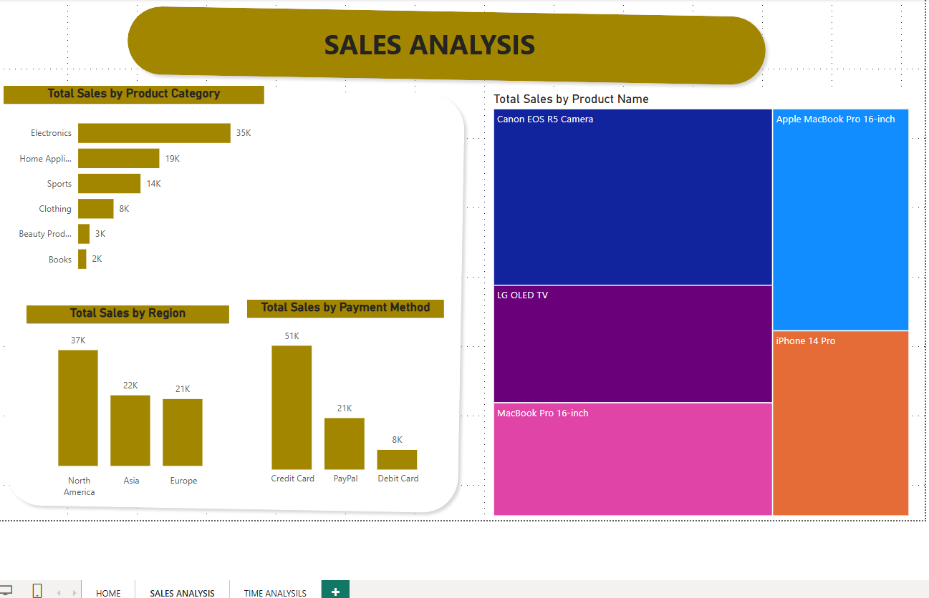

Slide 5
Slide 2: Sales Analysis - Breakdown by Categories & Methods
This slide, titled "SALES ANALYSIS", delves deeper into sales distribution across various dimensions.
Total Sales by Product Category:
Electronics: 35K (Highest)
Home Appliances: 19K
Sports: 14K
Clothing: 8K
Beauty Products: 3K
Books: 2K (Lowest)
Total Sales by Region:
North America: 37K (Highest)
Asia: 22K
Europe: 21K
Total Sales by Payment Method:
Credit Card: 51K (Highest)
PayPal: 21K
Debit Card: 8K (Lowest)
Total Sales by Product Name (Treemap):
Visually represents sales contribution of individual products, with larger areas indicating higher sales (e.g., Apple Macbook Pro 16-inch, Canon EOS R5 Camera, LG OLED TV, iPhone 14 Pro, MacBook Pro 16-inch).

Slide 6
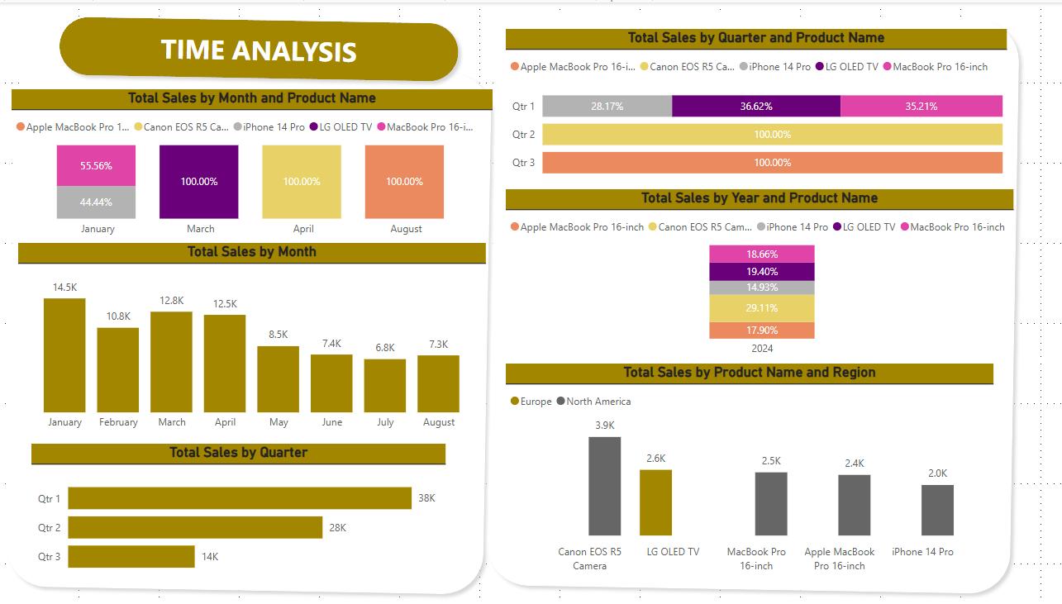

Slide 7
Slide 3: Time Analysis - Sales Trends & Product Performance Over Time
This slide, labeled "TIME ANALYSIS", focuses on sales trends and product performance over different time periods.
Total Sales by Month and Product Name:
Shows monthly sales contribution for selected products (e.g., Apple Macbook Pro 16-inch, Canon EOS R5 Camera, LG OLED TV, MacBook Pro 16-inch) with percentage breakdowns. Highlights variations like March, April, and August showing 100% for some products.
Total Sales by Month:
Bar chart showing monthly sales figures (e.g., January: 14.5K, February: 12.8K, March: 12.5K, etc., up to August: 7.3K).
Total Sales by Quarter:
Qtr 1: 38K
Qtr 2: 28K
Qtr 3: 14K (Lowest)
Total Sales by Quarter and Product Name:
Percentage breakdown of product sales within each quarter.
Total Sales by Year and Product Name:
Shows annual sales contribution by product, specifically for the year 2024, with percentage breakdowns.
Total Sales by Product Name and Region:
Compares product sales between Europe and North America (e.g., Canon EOS R5 Camera: Europe 3.9K, North America 2.6K, etc.).

